Slide 1
House Price Prediction

Slide 2
Abstract
House Price Forecasting Is An Important Topic Of Real Estate. The Literature Attempts To Derive Useful Knowledge From Historical Data Of Property Markets. We Tried To Analyze House Prices Of The City Named Pune. In This Experiment We Have Performed Analysis On Only One Dataset. This Experiments Tries To Give The Expected Price Of The House Based On Site Location Entered By User And Also Number Of BHK’s. This Full Experiment Is Performed By Using Libraries: Numpy ,Pandas ,Babel ,Pandas-Profiling , Statistics & Matplotlib.

Slide 3
Aim
These Are The Parameters On Which We Will Evaluate Ourselves-
Created An Effective Price Prediction Software.
Identified The Important Home Price Attributes Which Feed The Software’s Predictive Power.

Slide 4
Description
Predicting House Prices Can Help To Determine The Selling The Right Price Of A House Of A Particular Region And Can Help People To Find The Right Time To Buy A Home.
In This Project On House Price Prediction, Our Task Is To Use Data From The Dataset To Predict House Prices In The City. The Data Includes Features Such As BHK, Sq. Ft, Site Location , Etc.
We Predicted Price In 2 Categories:
For Houses Which Are Ready-to-move
For Houses Which Are Not Yet Ready
We Use The Following Python Library For Our Project:-
Numpy
Pandas
Matplotlib
Babel
Statistics

Slide 5
Prerequisites
Numpy
Pandas
Matplotlib
Excel

Slide 6
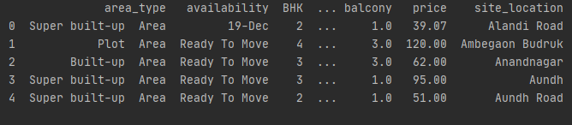
Dataset
Our Data Contains Pune Houses Only & The Dataset Contains Approx. 12,000 Houses.
Dataset looks as follows-

Slide 7
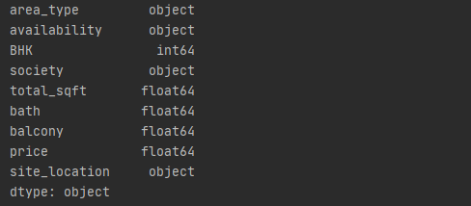
Dataset

Slide 8
How it Works?
First Step We Have Performed Is To Collect The Site Location, BHK And
Sq. Ft From User.
After Collecting This, We Compare Site & BHK To Our Data And Then From That Fetched Data We Try To Compare Total Counts To 10.
If Count < 10, Then We Directly Find Mean Of Price Per Sq. Ft Of The Fetched Data. And Then Predicts Its Price That Way.
If Count >= 10, Then We Plot The Scatter Plot Between ‘Price Per Sq. Ft’ And ‘Sq. Ft’ And From That Plot We Try To Remove Outliers For Getting Exact Predicted Price By Applying Following Formula:-
q1_perfeet=reqrows.perfeet.quantile(0.25)
q3_perfeet=reqrows.perfeet.quantile(0.75)
iqr=q3_perfeet-q1_perfeet
lowerlimit=q1_perfeet-1.5*iqr
upperlimit=q3_perfeet+1.5*iqr

Slide 9
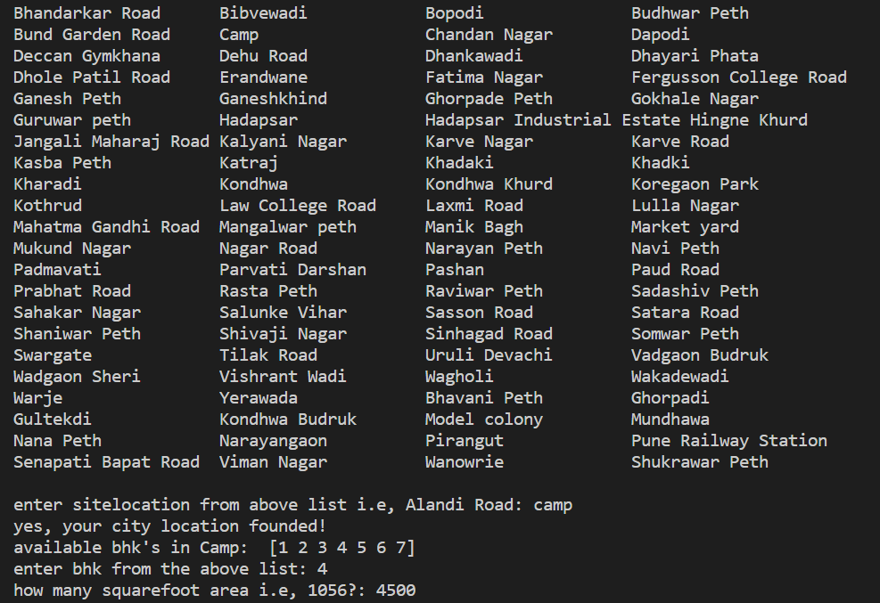
Input :

Slide 10
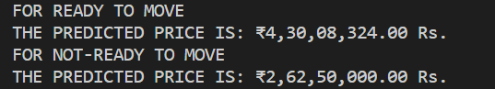
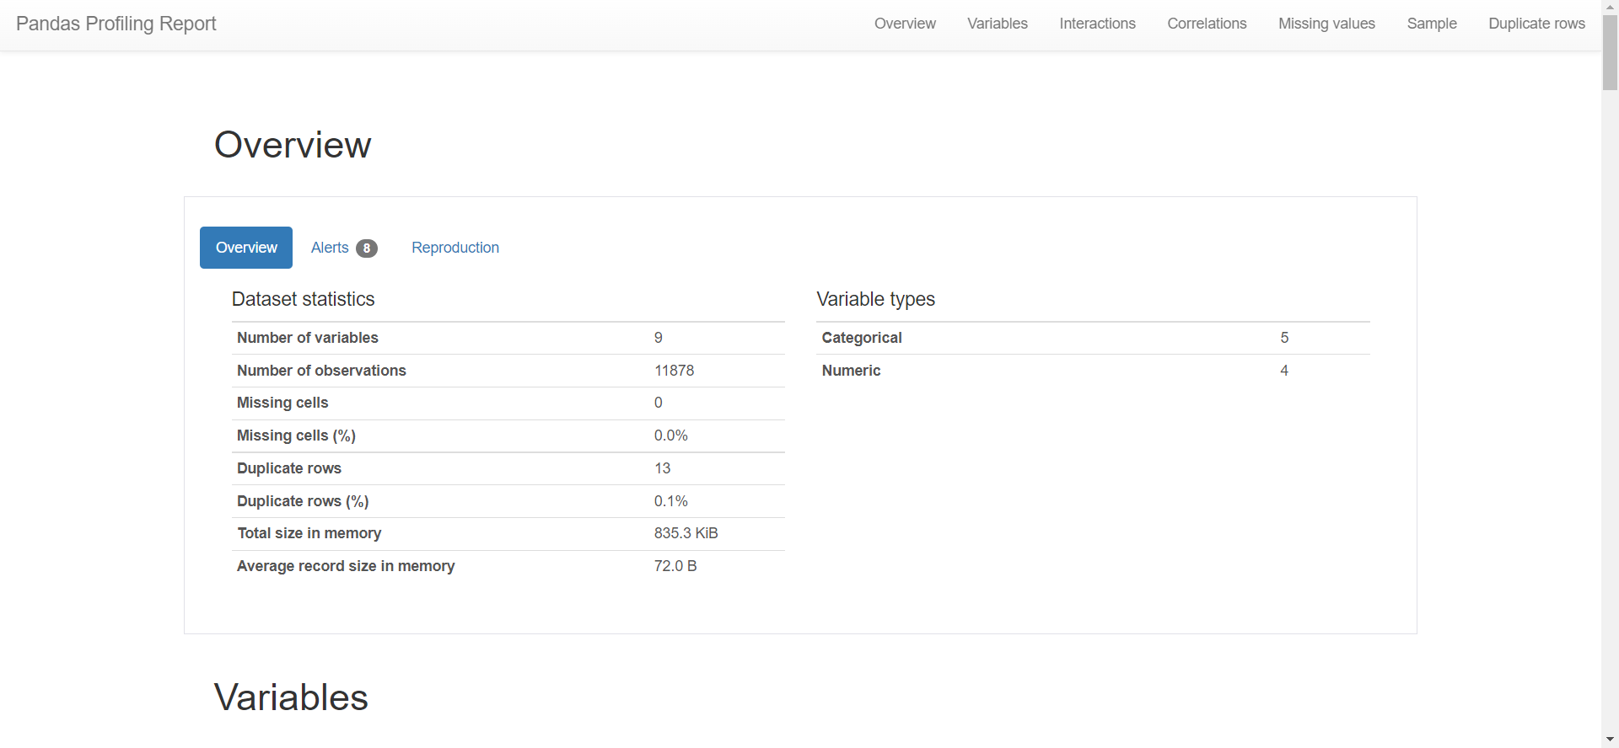
Output :
Analyzed Report

Slide 11
Conclusion
So, Our Aim Is Achieved As We Have Successfully Ticked All Our Parameters As Mentioned In Our Aim Column. It Is Seen That Our Prediction Is Too Accurate When Our Total Count Is Greater Than 10. Else Accuracy Is Reduced.

Slide 12
A Project BY:-
Kaiyur Maheshwari
Nisharth Chauhan

